Slide 1


Massively Open Online Course System for Seerat-Un-Nabi
Group Members
Rida Fatima
Fatima Gull
Muhammad Usman
Rimsha Javed
Supervised By
Muhammad Sajid Qureshi

Slide 2
Contents
Introduction
Features
Work Load
Functional Requirements
Non-Functional Requirements

Slide 3
Contents(Cont.)
Block Diagram
Use Case Diagram

Slide 4
Introduction
A Learning and Testing System for Seerat-Un-Nabi(PBUH). It is a web-based application facilitating the distant learners of Seerat-Un-Nabi(PBUH). The software enables the learners to learn Seerat-Un-Nabi(PBUH) in a systematic way, on their own pace, beyond the geographical boundaries. The System will provide Authentic learning resources with references.

Slide 5
Problem
Need of an intelligent, integrated and automated learning environment for better understanding of the message of Seerat-Un-Nabi(PBUH).
Existence of no Online Computer Based Testing System to test understanding of Seerat-Un-Nabi(PBUH).
Unavailability of Standardized Learning Content to the learners
Need of support for Self-Paced Learning about Prophet(PBUH).
Need of facilitation to the distant learners of Seerat-Un-Nabi(PBUH).

Slide 6
Solution
Provision of an Online Computer Based Testing System to test understanding of Seerat-Un-Nabi(PBUH)
Standardized testing of Seerat-Un-Nabi(PBUH)
Self-Paced Learning of Seerat-Un-Nabi(PBUH)
Provision of Standardized Learning Content to the learners
Facilitating the distant learners of Seerat-Un-Nabi(PBUH)

Slide 7
Features
Define Course
Course Offering
Learner’s Registration
Course Joining
Learner’s Performance Evaluation
Learner’s Progress Monitoring
Interactive Learning
Peer Review Assignment
Result Compilation
Learner’s Feedback
E-Certificate

Slide 8
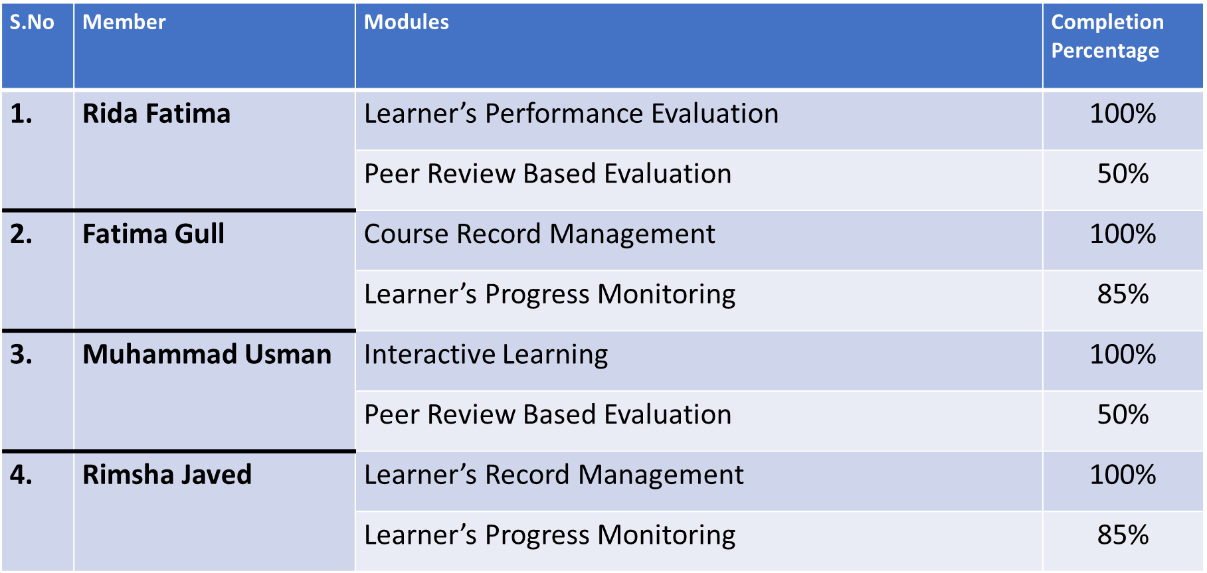
Work Load Distribution

Slide 9
Functional Requirements
Course Definition
Course Offering
Learner’s Registration
Course Joining
Learner’s Progress Monitoring
Learner’s Performance Evaluation
Interactive Learning
Practice & Graded Tests
Peer Review Assignment
Automated Comments on the Result(doubt)
Result Compilation
E-Certificate

Slide 10
Non-Functional Requirements
Performance Requirements
Quick Response Time
User Friendliness
Quality Attributes
Accessibility
Reliability

Slide 11
Block Diagram

Slide 12
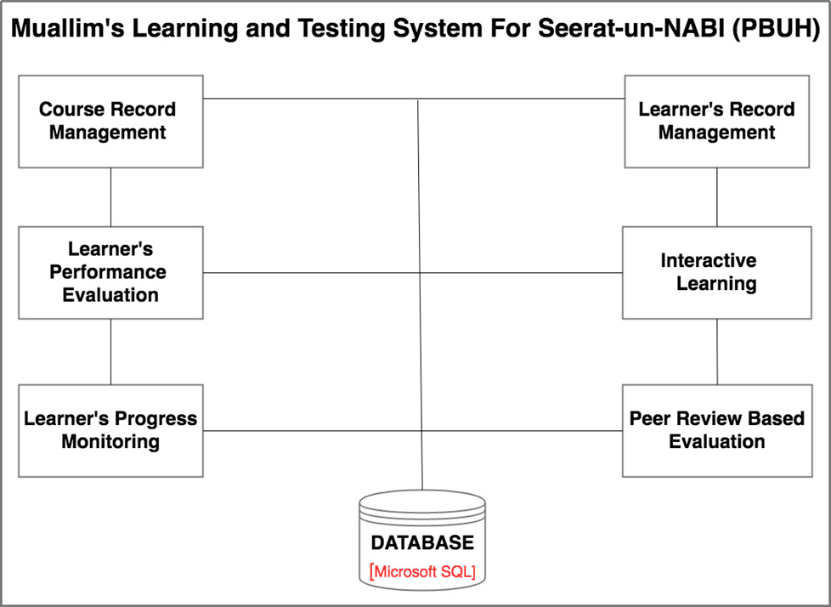

Slide 13
Use Case Diagram

Slide 14
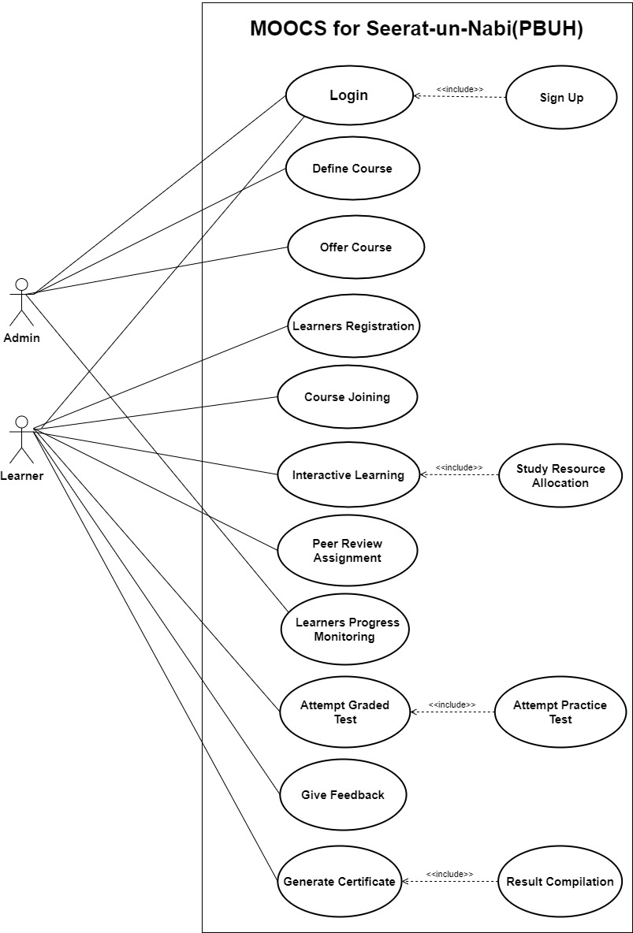

Slide 15
Thank You

